Slide 1



A short Briefing on Report Hospitality Analytics

Slide 2

For the project of hospitality finance analysis, I worked upon the data provided by the institute.
First of all, I have gone through the data and the my aim is to develop a interactive dashboard on either tableau or powerbi.
In that I have followed the following stages to complete the dashboard.
Load the data
Transform the data
Data modelling
Developing the KPIs
Created columns or measures in powerbi and calculated field and parameters in tableau
Developing the visualizations and created the Dashboard

Slide 3
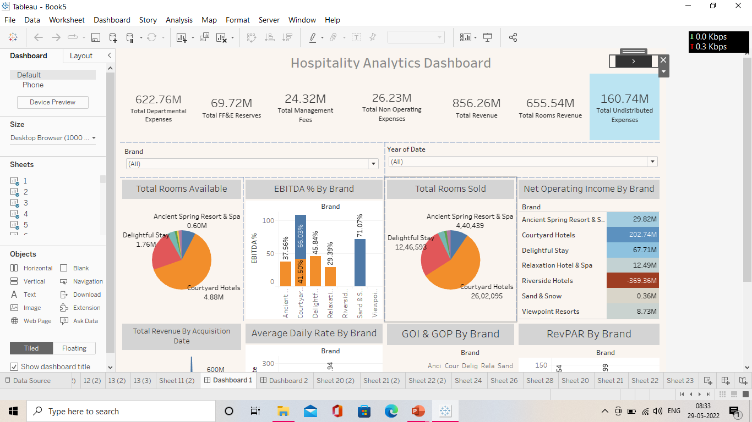
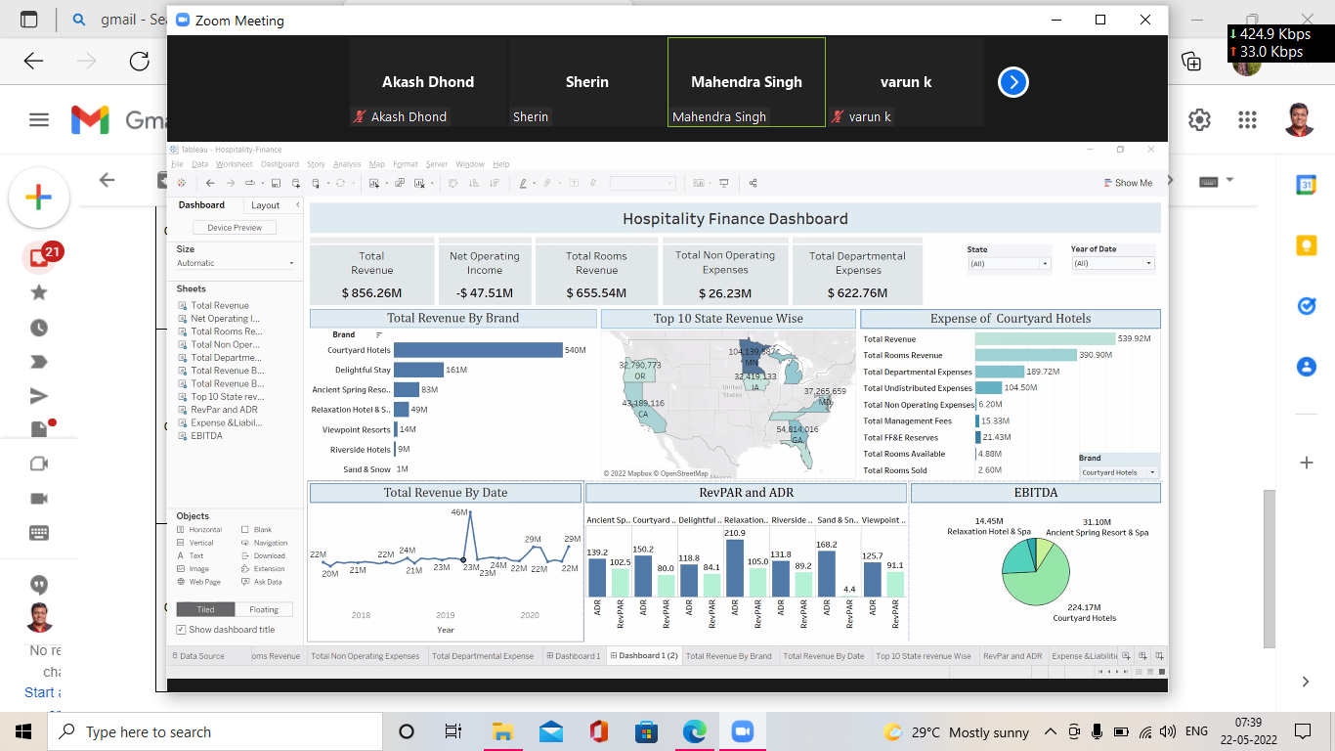
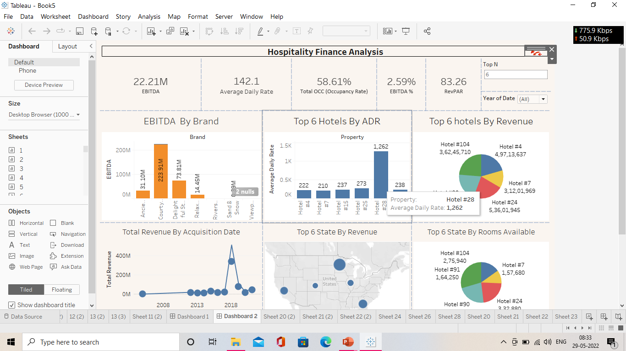
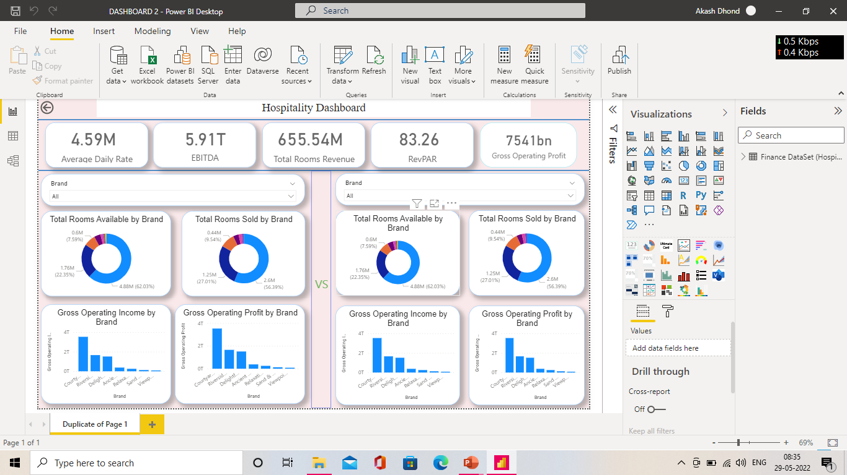

Slide 4

Thank you

